Slide 1
Educator initiative Grants Workshop
Presented by Trina Larsen, CCSD Grant Writer

Slide 2
Educator Initiative Grants
Presented by Trina Larsen, Grant Writer
This workshop will address the following:
What are Educator Initiative Grants?
How do I apply?

Slide 3
What is a Grant?
Presented by Trina Larsen, Grant Writer
Methods to fund ideas and projects to provide public services
Support for critical recovery initiatives, innovative research, etc.
Grants are not “free money” with no strings attached

Slide 4
Why do BOTH CCSD & CCSF Seek Grant Funding?
Presented by Trina Larsen, Grant Writer
Facilitate supplemental programming due to limited budgets
Provide services and programs schools cannot otherwise fund
Without supplemental grants, beneficial programs for students are often eliminated

Slide 5
Why does the Cherry Creek Schools foundation offer teachers “Educator initiative grants?”
Presented by Trina Larsen, Grant Writer
Educator Initiative Grants (EIG) are awarded to individual classroom teachers or teams teaching within Cherry Creek Schools.
The grants are designed to encourage, facilitate, recognize, and reward creative, inclusive and innovative instructional approaches used to accomplish program objectives.
These Grants are a greenhouse for nurturing new and potentially scalable instructional programs.
Grant requests of up to $1,200 are awarded.
The Foundation requests a subsequent evaluation to determine IMPACT to the students.

Slide 6
Why does the Cherry Creek Schools foundation offer teachers “educator initiative grants?”
Presented by Trina Larsen, Grant Writer
During the 2020-21 school year, Cherry Creek Schools Foundation approved $113,000 for a total of 127 grants to be given to Cherry Creek Schools educators.
These grants impacted more than 40,000 students within the district to further new innovative educational opportunities.
The impacts of these grants will be felt by more than one-in-two students across the district.

Slide 7
Why does the Cherry Creek Schools foundation offer teachers “Educator initiative grants?”
Presented by Trina Larsen, Grant Writer
Limited school budgets to fund supplemental programming
Provide services and programs schools cannot otherwise fund
Prevent teachers from spending their own money on classroom supplies
Without supplemental grants, beneficial programs for students are often eliminated

Slide 8
the Cherry Creek Schools foundation is dedicated to:
Presented by Trina Larsen, Grant Writer
Impacting all students
Investing in innovation in the classroom
Providing opportunities for every student to achieve to the best of their ability

Slide 9
Educator initiative grants Guidelines Fall 2022
Presented by Trina Larsen, Grant Writer
Purpose:
The Educator Initiative Grants (EIG) are designed to encourage, facilitate, recognize and reward creative, inclusive and INNOVATIVE instructional approaches used to accomplish program objectives with an emphasis on diversity, equity and inclusion for all students within the classroom.
Innovation is the application of better solutions that meet new requirements, unarticulated needs or existing market needs.

Slide 10
Educator initiative grants Guidelines Fall 2022
Presented by Trina Larsen, Grant Writer
Persons Eligible to Apply for Grants:
Individuals or teams of individuals employed by Cherry Creek Schools who are involved in teaching and supporting students are eligible to apply.
Eligible employees include both certified and classified.
Parents or PTCO may assist in the writing of the grant application. However, the educator will be held responsible for implementation and evaluation.

Slide 11
Educator initiative grants Guidelines Fall 2022
Presented by Trina Larsen, Grant Writer
Eligible Proposals and Grant Term:
Grants designed to begin and to be completed during the 2022-23 school year are eligible for submission.
Funds cannot be carried over to the next school year and unused funds or funds not reconciled will be returned to CCSF.

Slide 12
Educator initiative grants Guidelines Fall 2022
Presented by Trina Larsen, Grant Writer
Award of Funds:
The Cherry Creek Schools Foundation will determine the number and dollar amount of awards.
Grant requests of up to $1,200 will be considered.
The Educator Initiative Grants generally will NOT fund requests for the following items: ribbons and awards, t-shirts, salaries or sub-time.
Any requests for technology will be reviewed for compatibility with existing district technology.

Slide 13
Educator initiative grants Guidelines Fall 2022
Presented by Trina Larsen, Grant Writer
Application Deadline:
All grants must be submitted online by September 26th, 2022, no later than 11:59 pm.
Applications received after the deadline will not be considered.
You will receive an email confirming the receipt of your full, completed application.

Slide 14
Educator initiative grants Guidelines Fall 2022
Presented by Trina Larsen, Grant Writer
Application Process:
Application available online at: https://ccsdfoundation.org
You can review a sample of an approved grant application on the Cherry Creek Schools Foundation website.
Applications must be reviewed and approved by your Principal or Director once your application is approved.
All applications must be submitted online.

Slide 15
Educator initiative grants Guidelines Fall 2022
Presented by Trina Larsen, Grant Writer
Application Process (Continued):
Applications will be reviewed by a committee made up of the following members:
At least three members of the Foundation Board of Directors.
At least one representative from the District central office administration.
Grant applications will be read by non-educators.
Please avoid educational jargon and acronyms.
It is beneficial to provide background information on programs, curriculum being used and general information to help readers understand your request.

Slide 16
Educator initiative grants Guidelines Fall 2022
Presented by Trina Larsen, Grant Writer
Application Process (Continued):
For each grant application submitted, the committee shall make one of the following recommendations:
(a) funded;
(b) funded with conditions and/or modifications;
(c) partial funding;
(d) not funded.
Applicants will be notified of the decisions by the end of October.

Slide 17
Educator initiative grants Guidelines Fall 2022
Presented by Trina Larsen, Grant Writer
Selection Criteria:
Represents a unique teaching approach to accomplishing program objectives.
Is aligned with district program objectives and clearly defines why it is needed in the school.
Contains a clear description of instruction that will happen.
Reflects one or more of the following values:
Whole well being
Relationships
Equity
Engagement
Growth mindset

Slide 18
Educator initiative grants Guidelines Fall 2022
Presented by Trina Larsen, Grant Writer
Selection Criteria (continued):
There is evidence of expected impact on students.
Incorporates sound evaluation procedures.
The proposal could be scalable and sustainable.
Could serve as a pilot program for other schools.
Projects are intended to provide a space for learning and growth for all, and do not harm, discriminate, or exclude any individuals or groups from participating.

Slide 19
Educator initiative grants Guidelines Fall 2022
Presented by Trina Larsen, Grant Writer
Terms & Conditions:
Use the grant for the purposes intended.
Agree to share successful procedures in staff development sessions or with other schools.
Complete the Educator Initiative Evaluation by June 30, 2023.
Recipients who do not complete the evaluation will be ineligible to apply for the next cycle of Educator Initiative Grants.
Provide the CCSF with one or more of the following: pictures, video, student testimonial, story to share with stakeholders about your grant.

Slide 20
Educator initiative grants Guidelines Fall 2022
Presented by Trina Larsen, Grant Writer
Terms & Conditions (continued):
Provide appropriate detail for itemized costs.
Detail any additional funding sources.
Ensure students in photos supplied to the Foundation have a signed media/photo release.
All materials received through an Educator Initiative Grant must stay within the Cherry Creek School District and used for students.
If a recipient leaves CCSD or moves to a non-instructional position, the materials will remain with the school.
If a recipient remains in an instructional position but moves positions within the school or within the CCSD, the materials received through the EIG will stay with the recipient.

Slide 21
Educator initiative grants Guidelines Fall 2022
Presented by Trina Larsen, Grant Writer
Grant Publicity:
CCSF appreciates any recognition you provide in print or electronic materials related to your funded project.
We encourage you to recognize CCSF as a funder in newsletter articles or other materials that are sent to your parents or community to enhance the awareness of CCSF to allow for increased funding of grants in future years.
We ask you to consider including a link to our website, www.ccsdfoundation.org, in any publicity materials.
For assistance in creating publicity materials or stories, or to request a CCSF logo, please contact Aimee MacDonald at 720-554-4429 or amacdonald3@cherrycreekschools.org.
We kindly request you submit thank you-letters, photos of the program in operation or quotes which we may publish on the CCSF website or in CCSF marketing materials.
Ensure students in photos have signed media/photo releases.

Slide 22
How do we Apply for teacher initiative grants?
Presented by Trina Larsen, Grant Writer
Website Link
https://ccsdfoundation.org

Slide 23
Application process for teacher initiative grants? Applicant Information
Presented by Trina Larsen, Grant Writer
First Name
Last Name
Job Title
Phone Number
Email Address
School
Grant Title
Number of Students anticipated to be Impacted

Slide 24
Application process for teacher initiative grants? Grant Application Questions
Presented by Trina Larsen, Grant Writer
Provide a brief description of your Grant project that can be used for publication
Funded grants will be publicized and require photographs and evaluation of project

Slide 25
Application process for teacher initiative grants? Grant Application Questions
Presented by Trina Larsen, Grant Writer
Purpose
Explain what you hope to achieve
What will be different or better if successful?
Why is it needed?
How is it INNOVATIVE?

Slide 26
Application process for teacher initiative grants? Grant Application Questions
Presented by Trina Larsen, Grant Writer
Measurable Objectives
Specific, Measurable, Attainable, Relevant, Time-Based (SMART) Goals
What are SMART Goals?
Specific (and strategic): Linked to position summary, departmental goals/mission, and/or overall goals and strategic plans
Measurable: The success toward meeting the goal can be measured
Achievable (and attainable): Goals are realistic and can be achieved in a specific amount of time and are reasonable.
Relevant: The goals are aligned with current tasks and projects and focus in on one defined area; include the expected result
Time-phased: Goals have a clearly defined time-frame including a target or deadline date
How will you know it is successful?

Slide 27
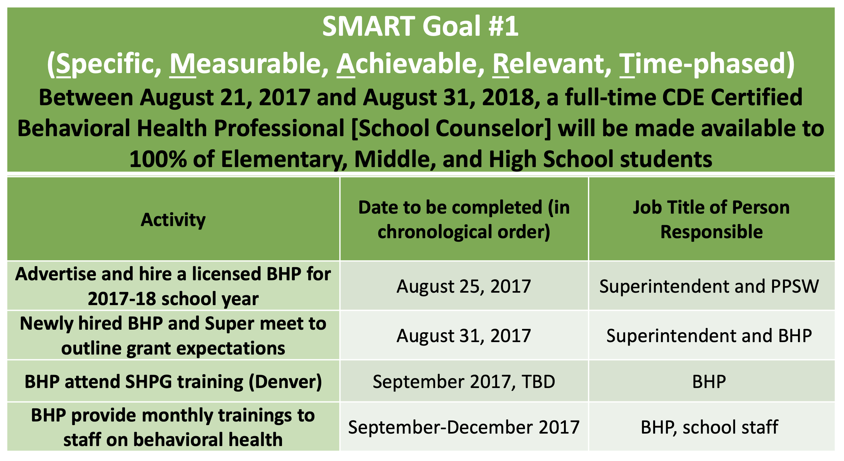
Application process for teacher initiative grants? Grant Application Questions
Presented by Trina Larsen, Grant Writer
Measurable Objectives
Specific, Measurable, Attainable, Relevant, Time-Based (SMART) Goals
Example of SMART Goal

Slide 28
Application process for teacher initiative grants? Grant Application Questions
Presented by Trina Larsen, Grant Writer
How will your grant achieve a District/School goal?
e.g., how will it focus on and support the 5 Core Values:
Whole Well Being
Relationships
Equity
Engagement
Growth-Mindset

Slide 29
Application process for teacher initiative grants? Grant Application Questions
Presented by Trina Larsen, Grant Writer
Implementation of Strategy
e.g., instructional procedures, steps of implementation

Slide 30
Application process for teacher initiative grants? Grant Application Questions
Presented by Trina Larsen, Grant Writer
Timeline
Provide outline of your grant from beginning to end
Sustainability plan
Will additional resources be needed in the future?

Slide 31
Application process for teacher initiative grants? Grant Application Questions
Presented by Trina Larsen, Grant Writer
Evaluation Procedures
Explain how you will measure the success of your program
Will you conduct a survey, interview, or request feedback from participants?

Slide 32
Application process for teacher initiative grants? Grant Application Questions
Presented by Trina Larsen, Grant Writer
School and/or Community Partners involved in the grant (optional, not required)
e.g., financial support or volunteer

Slide 33
Application process for teacher initiative grants Budget Questions-DO NOT USE DOLLAR SIGNS
Presented by Trina Larsen, Grant Writer
Budget Narrative:
Explain what is being purchased and how it relates to the goals of the project.
Equipment/Supplies:
Item, cost, description
Item | Cost ($) | Description

Slide 34
Application process for teacher initiative grants Budget Questions
Presented by Trina Larsen, Grant Writer
Other:
e.g., Guest speakers, scholarships, travel, postage, etc.
Item, cost, description (use the total cost of each item)
Item | Cost ($) | Description

Slide 35
Application process for teacher initiative grants Budget Questions
Presented by Trina Larsen, Grant Writer
Total Amount Requested up to $1200 for the entire grant ($):
(Enter Amount)

Slide 36
What do we write grants about?
Presented by Trina Larsen, Grant Writer
Generating revenue to create, supplement, expand, and/or sustain an initiative, project, or program
Academic success of students (Instructional Excellence)
Professional development for educational staff (Workforce Excellence)
Physical and psychological safety for students, families, educators, schools, district community members (Operational Excellence)
Serving underrepresented groups and vulnerable populations
Moving the District toward one of many goals or desired outcomes with evidence of successful results
Overcoming substantial budget reductions to District funding
Supporting the 5 Core Values

Slide 37
Cherry Creek Schools Foundation
Presented by Trina Larsen, Grant Writer
Contact Name | Title | Email Address | Phone Number
Jill Henden | Executive Director | jhenden@cherrycreekschools.org | (720) 554-4409
Jordan Evins | Development Manager | jevins@cherrycreekschools.org | (720) 554-4450
Aimee MacDonald | Executive Assistant | amacdonald3@cherrycreekschools.org | (720) 554-4429
Heather Tinley | Coordinator, Public Relations and Marketing | htinley@cherrycreekschools.org | (720) 554-4252

Slide 38
Presented by Trina Larsen, Grant Writer
Are you ready to write?

Slide 39
Time for homework
Presented by Trina Larsen, Grant Writer
Develop a grant idea for the District, a specific department, or a school
Create your collaborative team (if applicable)
Gather data/information
Outline your program/project
Calculate your budget
Develop a plan on how you will evaluate your program/project
Address sustainability plan after the grant ends

